Slide 1

Cybersecurity Threat Intelligence Concept Mapping
Cyber Security Operations
Professor: Vidu Mishra
Group 4
Group Members :
Masira Sajidbhai Vahora
Golyas Bagherzadeh Ansari
Sunit Jishtu
Kelechi Nwaozuru

Slide 2
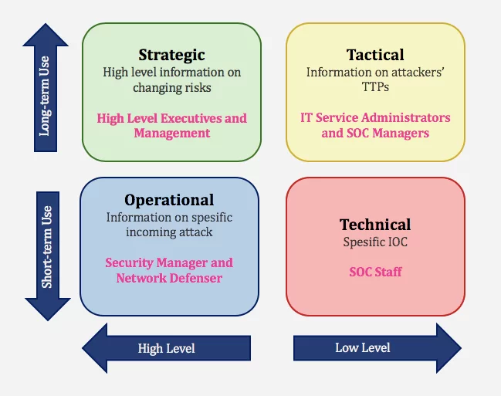
What is Threat Intelligence?
Threat intelligence is gathering, analyzing and sharing information about potential or existing threats to an organization’s security.
Key Points:
Strategic CTI: Long-term trends and big-picture insights
Tactical CTI: Specific tactics, techniques, and procedures (TTPs) of attackers
Operational CTI: Real-time intelligence for ongoing attacks
Technical CTI: Specific technical details, e.g., malware signatures and IP addresses

Slide 3
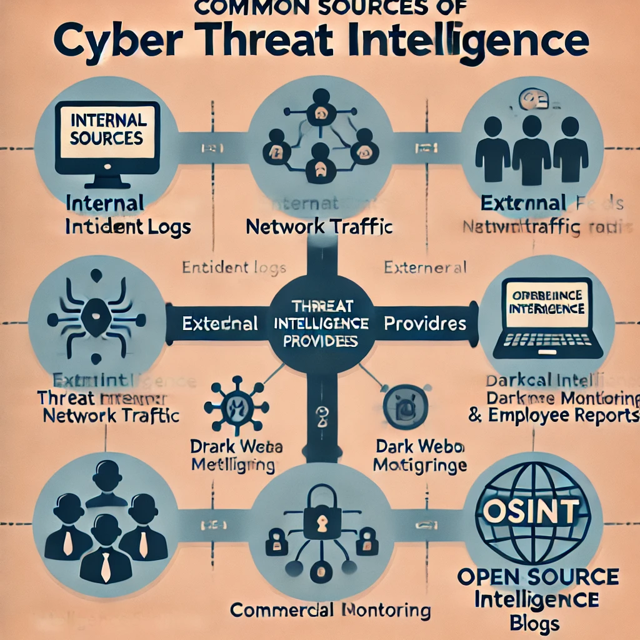
Common Sources Of Threat Intelligence
Internal Sources: Incident logs, network traffic, employee reports
External Sources: Threat intelligence feeds, dark web monitoring, public vulnerability databases (e.g., CVE)
Commercial Providers: Specialized threat intelligence services
Open-Source Intelligence (OSINT): Public websites, social media, forums, and blogs

Slide 4



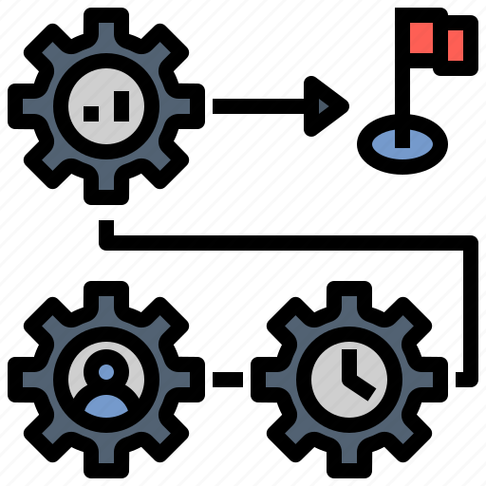
Strategic
Intelligence explains threats for non-technical audience.
Tactical
Intelligence describes threat conditions for technical audience.
Technical
Intelligence focuses on specific threat techniques.
Operational
Intelligence details hacker information and intent.
Types of Cyber Threat Intelligence

Slide 5
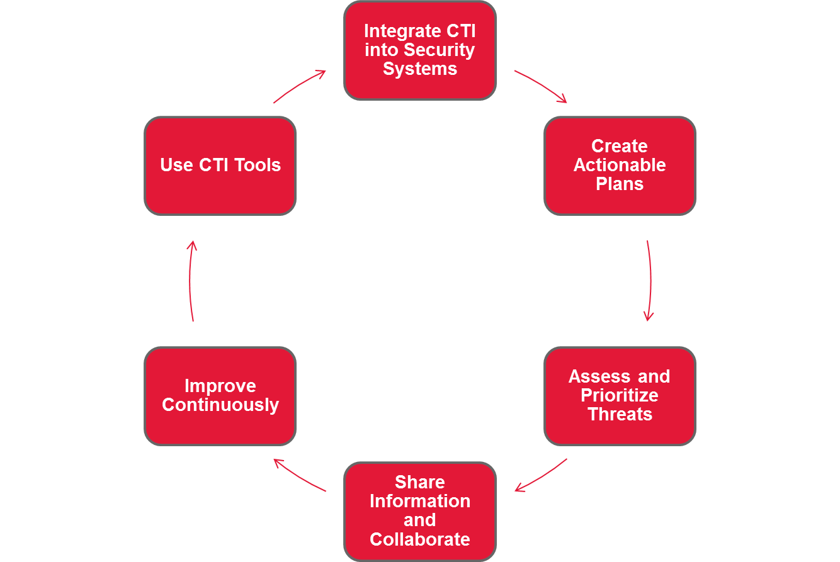
How do you operationalize cyber threat intelligence?
Integrate CTI into Security Systems
Automate threat feeds into security tools.
Monitor for threats in real-time.
Create Actionable Plans
Develop incident response playbooks.
Implement preventive measures.
Assess and Prioritize Threats
Prioritize risks based on impact.
Align intelligence with your organization’s environment.
Share Information and Collaborate
Collaborate internally across teams.
Share intelligence with trusted external partners.
Improve Continuously
Gather feedback from past incidents.
Train teams on new threats and techniques.
Use CTI Tools
Implement CTI platforms for analysis.
Visualize and interpret threat data for better decisions.
cyber threat intelligence

